Slide 1



Ad hoc Insights
Consumer Goods
CREATED BY
JAIDEEP SINGH

Slide 2

AGENDA
Background
Getting familiar with Atliq’s Business And Their Markets
Getting Familiar With Data
Analyzing And Solving Ad-hoc requests With Visualizations And Insights

Slide 3
Background
AtliqHardware (fictitious corporation) is one of the major computer hardware manufacturers in India, with a strong presence in other nations.
The management noticed that they do not get enough insights to make quick and smart data-informed decisions.
Tony Sharma, their data analytics director wanted to hire someone who is good at both tech and soft skills
The company seeks insights for 10 ad hoc requests.
Approach is to Run a SQL query to answer these requests.

Slide 4
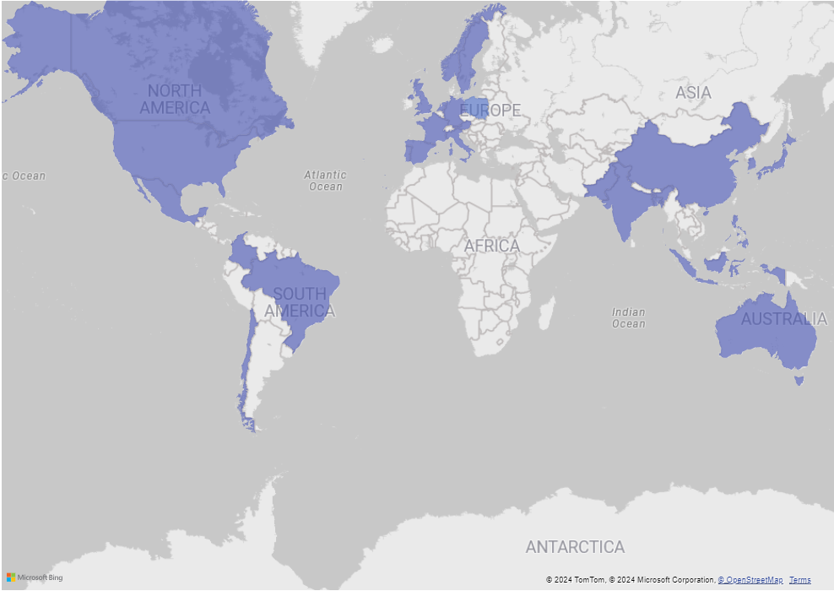
Getting familiar with Atliq’s Business And Their Markets
Atliq Hardware is actively doing business in 27 countries across NA, EU and APAC region

Slide 5
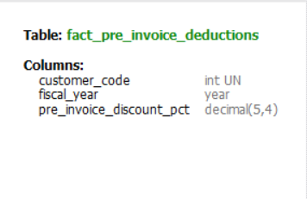
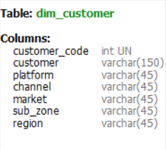
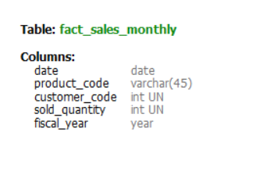
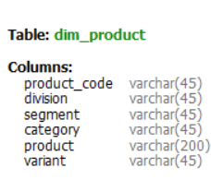
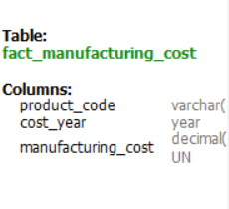
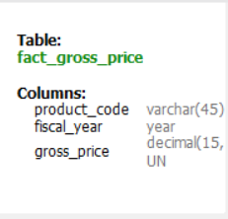


DATA AND TOOLS
Input data consists of sales data for FY 2020 and FY 2021.

Slide 6

Analyzing And Solving Ad-hoc requests With Visualizations And Insights

Slide 7
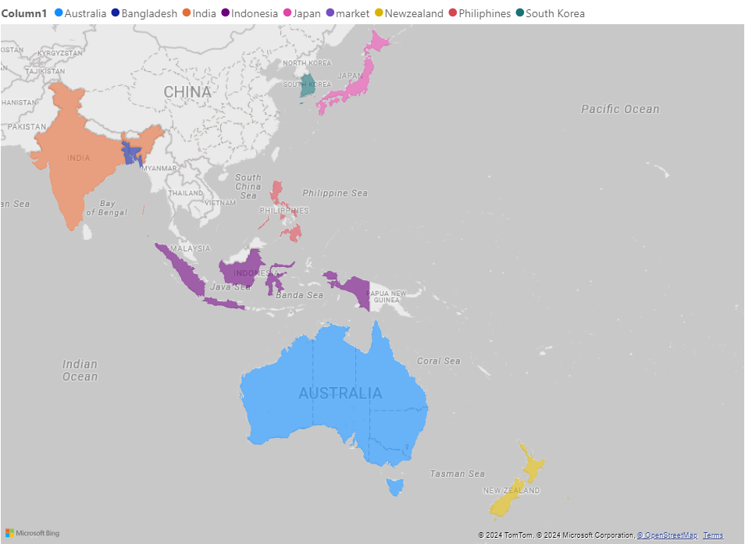
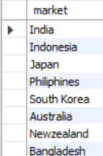
1. Provide the list of markets in which customer "Atliq Exclusive" operates its business in the APAC region.

Slide 8
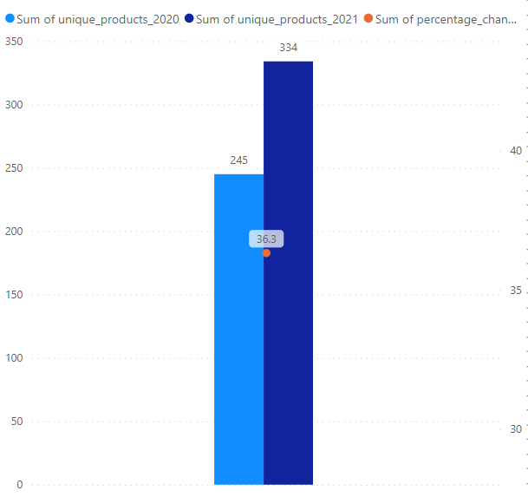
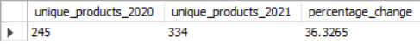
2. What is the percentage of unique product increase in 2021 vs. 2020? The final output contains these fields:
unique_products_2020
unique_products_2021
percentage_chg
Insights:
It’s a good sign that we are continuously innovating and introducing new products to the market ,36% Increase .

Slide 9
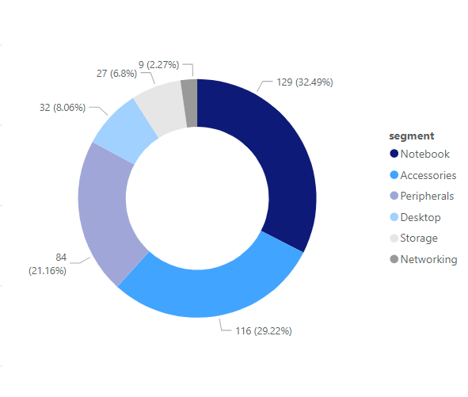
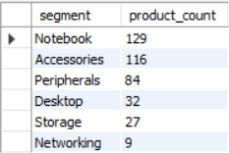
3. Provide a report with all the unique product counts for each segment and sort them in descending order of product counts. The final output contains 2 fields:
Segment
product_count
Insights:
Notebooks Segment have maximum unique products (129) where as Networking has least number unique product(9)
Segments: notebooks, accessories, and peripherals are showing significant growth
need of diversification in production of products in Desktop, Networking, and Storage segments

Slide 10
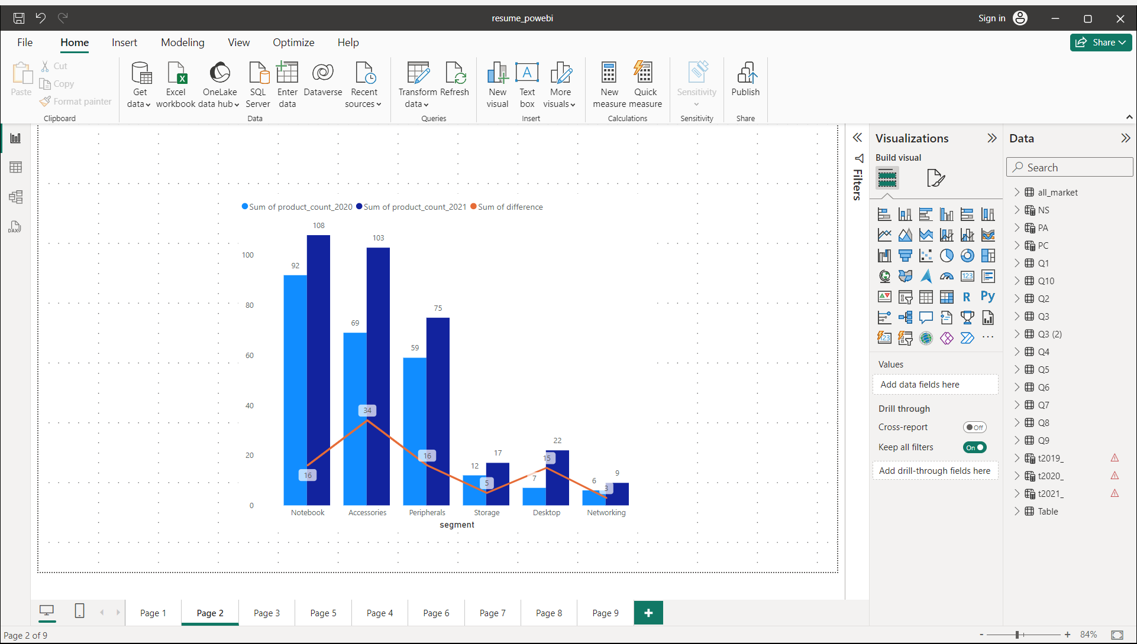
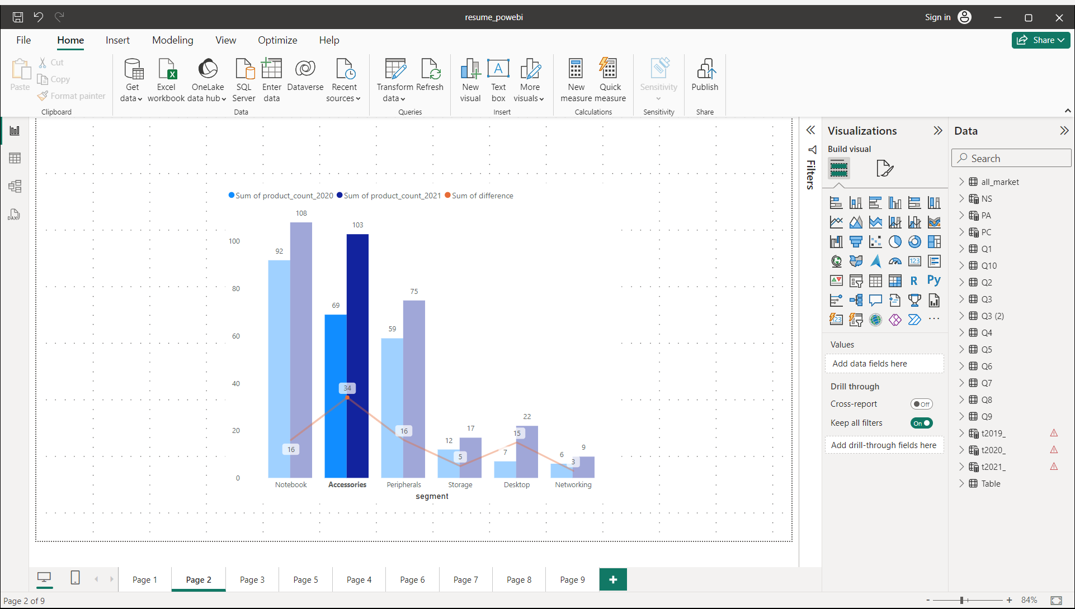
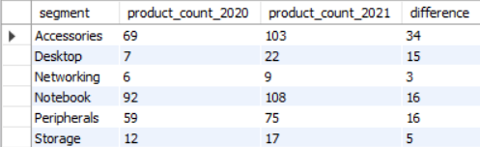
4. Follow up: Which segment had the most increase in unique products in 2021 vs 2020? The final output contains these fields:
segment
product_count_2020
product_count_2021
difference
Insights:
Accessories had largest increase in production (34 new products introduced between FY2020-FY2021)
Segments: Networking, Storage are showing Slow Growth rate Compared to our other segments (3,5 new products Respectively introduced between FY2020-FY2021)

Slide 11


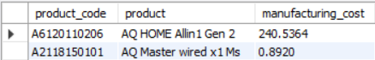
5.Get the products that have the highest and lowest manufacturing costs. The final output should contain these fields:
240.54$
0.89$
product_code
product
manufacturing_cost
: AQ Home Allin1 Gen2
AQ Master wired x1 Ms
Insights:
Mouse: AQ Master wired x1 Ms has the lowest manufacturing cost(0.89$).
Personal Desktop: AQ Home Allin1 Gen2 has the highest manufacturing cost(240.54 $).

Slide 12
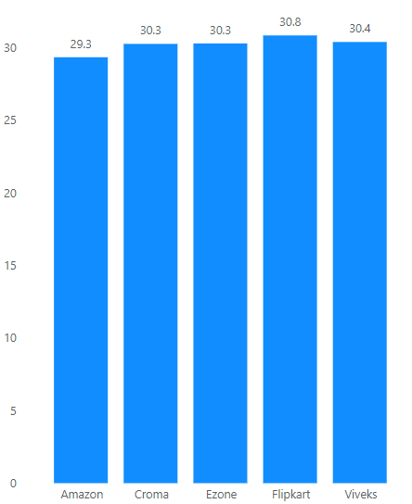
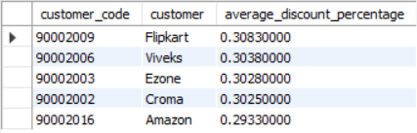
6.Generate a report which contains the top 5 customers who receive an average high pre_invoice discount_pct for the fiscal year 2021 and in the Indian market. The final output contains these fields:
Insights:
In 2021,we offered similar pre invoice discount percentages to each of our top 5 customers
Flipkart is the most discounted costumer in Indian market(30.83%) where as Amazon is the least discounted costumer in the Indian market(29.3%)

Slide 13
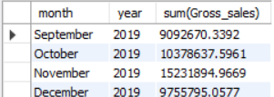
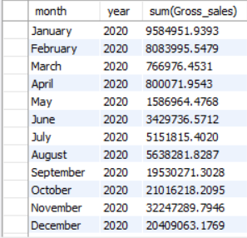
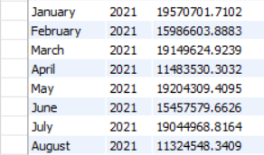
7. Get the complete report of the Gross sales amount for the customer “ AtliqExclusive” for each month. This analysis helps to get an idea of low and high performing months and take strategic decisions. The final report contains these columns:
FY 2020
FY 2021
Month
Year
Gross sales Amount

Slide 14
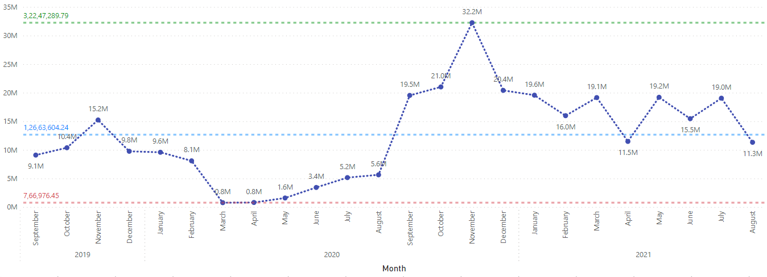
FY 2020
FY 2021
Insights:
total sales of “ AtliqExclusive” is 303.92M (79.5 M FY2020,224.42M FY2021)
For company November 2020 Marked the highest sales(32.2M) and March 2020 Marked the lowest Sales(0.77M)
This is due to Silicon chip Crisis happening because of COVID-19
But sales soon recovered and reach to its maxima in November 2020

Slide 15
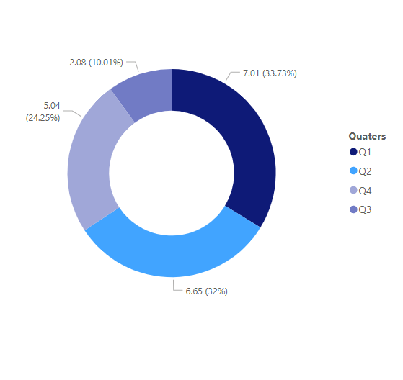
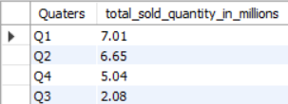
8.In which quarter of 2020, got the maximum total sold quantity ? The final output contains these fields sorted by the total sold quantity:
Quarter
total_sold_quantity
Insights:
Quarter 1 has the maximum total sold quantity(7.01M)
Our Sold Quantity Decreased in Quarter 3 Due to COVID-19 and Global Silicon Chip Crisis
But we soon recovered as Demand for PC and other equipment increased due to Work from Home Culture During Pandemic

Slide 16
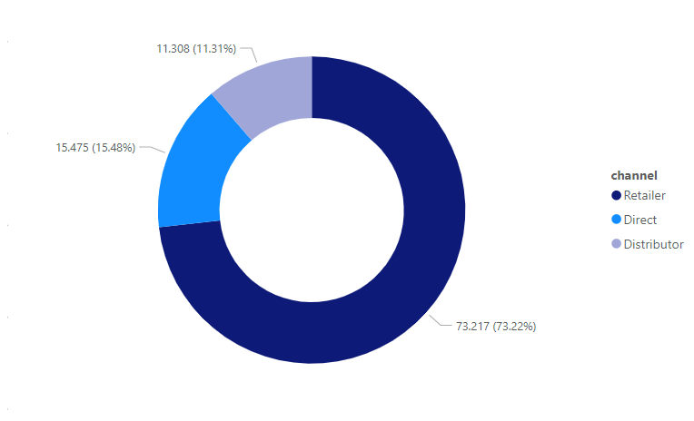
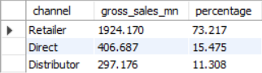
9.Which channel helped to bring more gross sales in the fiscal year 2021 and the percentage of contribution? The final output contains these fields:
channel
gross_sales_mln
percentage
Insights:
The majority of our sales took place via retailers , which is 73.217% of the total sales
Distributor Makes the least Contribution in our Gross Sales

Slide 17
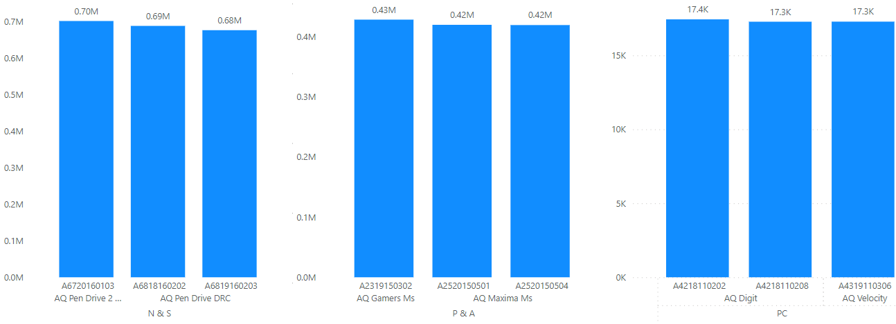
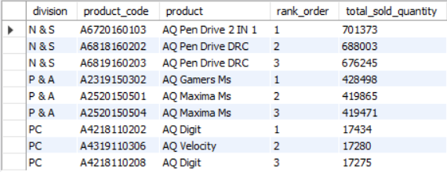
10.Get the Top 3 products in each division that have a high total_sold_quantity in the fiscal_year 2021? The final output contains these fields:
division
product_code
Product
total_sold_quantity
rank_order
Insights:
The top 3 selling products in N&S were pen drives
The top 3 selling products in P&A were mouse
The top 3 selling products in PC were personal laptops

Slide 18


THANK YOU
www.linkedin.com/in/jaideepsinghdhunna
https://github.com/singhjaideep1098
Jaideep Singh
B-Tech Computer engineer Undergraduate
Thapar Institute of engineering and technology, Patiala

